Slide 1
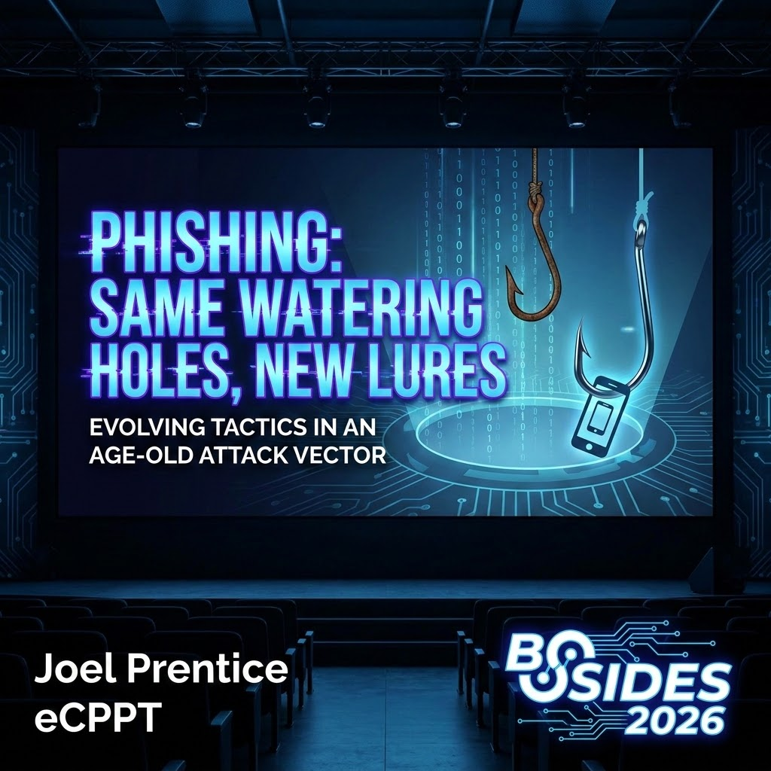
Notes:
The Detail: "It’s 8:15 AM. Most of us are still waking up. This engineer—let's call him Dave—is sitting in his home office or maybe at his desk in the utility's HQ. He’s looking at a legitimate Outlook window. The sun is hitting his desk. It’s a completely normal Tuesday.“
The Psychological Hook: "He’s not looking for a threat. He’s looking for a way to get through his 'To-Do' list. When that notification pops up for the 'North Lebanon Infrastructure Assessment,' it doesn't trigger a single alarm bell. Why would it? It’s exactly what he was working on yesterday."
The Experience: "He clicks the link. The browser spins for a second. He sees the Microsoft 'Sign-In' page. We’ve all seen it ten thousand times. The branding is perfect. The 'Privacy & Cookies' links at the bottom work. He types his username. He types his password. He’s not being 'tricked' by a typo-squatted domain or a weird layout. He is looking at a live-stream of the real Microsoft.“
The MFA Moment: "Then the push hits his phone. Ping. He doesn't even think about it. It’s muscle memory. Tap. Approve. He’s in. He sees the PDF. He spends ten minutes reading it. In his mind, he just had a productive morning."
The Pivot: "But while Dave is reading that PDF, something is happening in the memory of a proxy server. That proxy didn't just pass him through; it cloned him. It didn't steal his password—Dave still has his password. It stole his authenticated state. By 9:30 AM, the attacker isn't 'trying' to get in. They are already at the table, drinking Dave's coffee, looking at Dave's emails, and Dave has no idea he’s been compromised."
The Nuance: "This is why the 'Valet' is so dangerous. He doesn't look like a thief in a mask. He looks like a part of the infrastructure. He stands between the user and the destination, providing a service. He gives you exactly what you want—access to your file—while he keeps the only thing that matters: your claim ticket."
The Intro: "I'm Joel David Prentice. I work in vulnerability management. "Today, we aren't just looking at phish. We’re dismantling the valet, packet by packet."

Slide 2
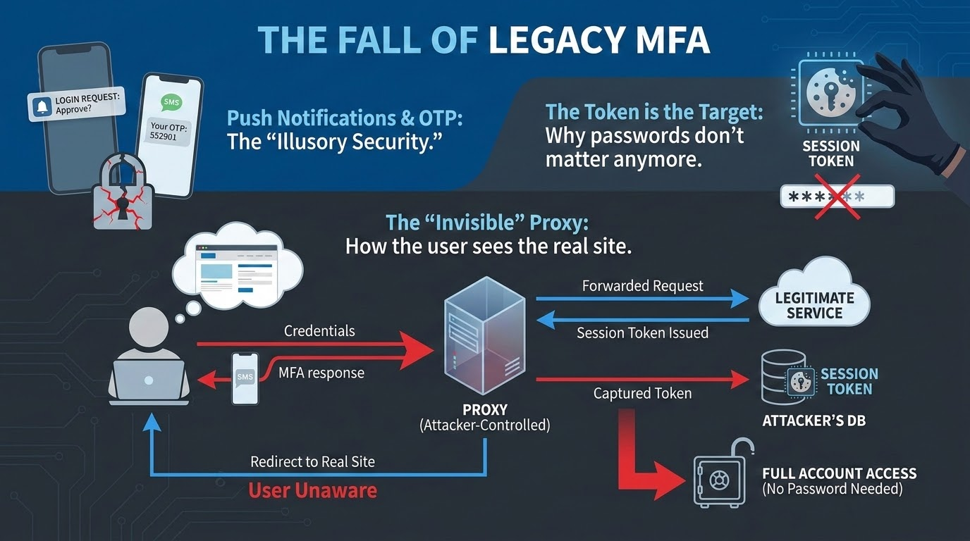
Notes:
The Pivot: "So, Dave’s car is gone. His identity is cloned. But how? It’s not because our encryption is broken. It’s because our protocols have a massive, structural blind spot. We’ve spent a decade telling our boards that MFA is the finish line—that if we just get to 100% enrollment, the game is over. But in 2026, we have to admit that compliance is just the floor. We are building massive security stacks on top of a foundation that is fundamentally 'context-blind.’”
The $20 Bill "Money Shot" (1:30 - 3:00)
"At the heart of this is how we handle identity. Most MFA we use—Push, SMS, the 6-digit codes—ends with the server handing the user a Bearer Token. Think of this like a $20 bill. If I drop this in the hallway of the Farm Show complex and you pick it up, it’s yours. The guy selling coffee doesn't care who I am; he just cares that you’re holding the cash. Our session cookies—specifically that ESTSAUTHPERSISTENT cookie—are digital cash. Because they aren't 'Sender-Constrained,' the attacker doesn't need to be 'Dave.' They just need to 'bear' the token. They pluck it out of the air in Pennsylvania and spend it in a data center in a different time zone. To the server, that’s not a hack; that’s just a guy with a twenty.“
The "Two-Channel" Forensic (3:00 - 4:30)
"Why didn't Dave's phone warn him? It’s the gap between the Front and Back channels. Dave is in the Front-Channel—the browser. The real handshake is in the Back-Channel. When that push notification hit Dave’s phone at 8:15 AM, it asked: 'Are you trying to sign in?' It’s a simple binary question. It didn't mention the proxy. It didn't mention the JA4 fingerprint mismatch. The phone has zero cryptographic proof of the Origin URL. We are asking our employees to make high-stakes forensic decisions based on a 'Yes/No' button that is functionally blind to the network metadata.“
The "14-Day" Reality Check (4:30 - 5:00)
"And then we have the Persistence Trap. We’ve all set those 14-day or 30-day session windows because we don't want to get yelled at about 'MFA Fatigue.' Attackers love our convenience. They know once they have that cookie, your Conditional Access is taking a nap. You’ve built a 'Zero Trust' architecture that trusts a stolen piece of text for two weeks straight. Dave’s 'one-second' mistake becomes the attacker’s 'month-long' residency."

Slide 3
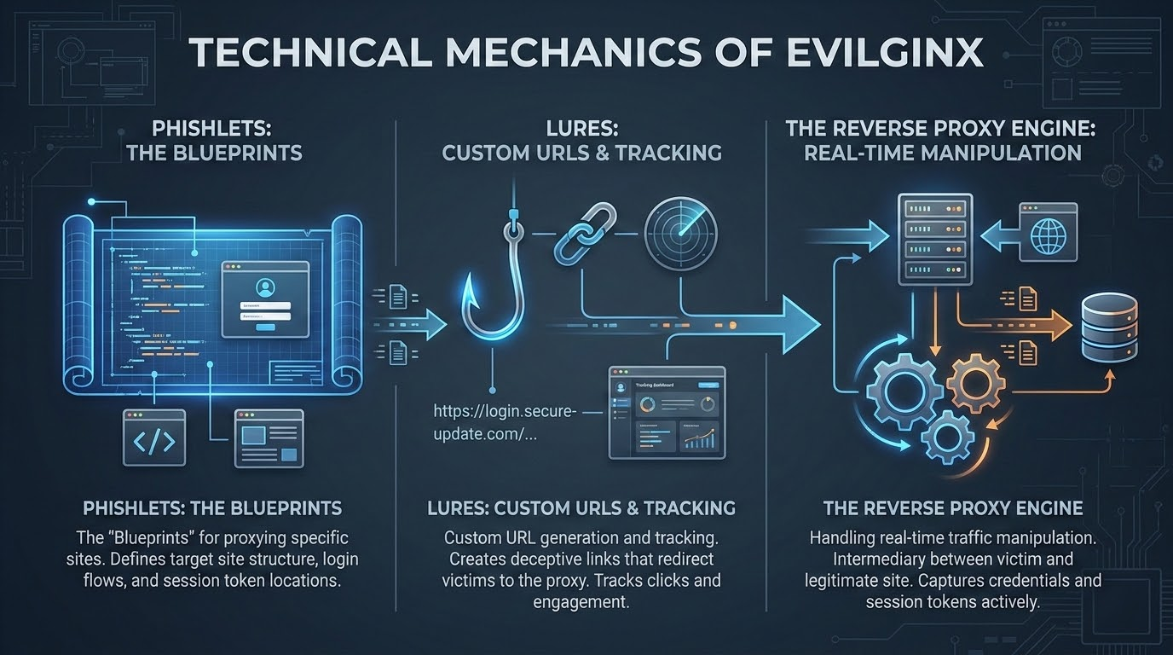
Notes:
Not a Clone: It’s a surgical, live-editing relay.
Search & Replace: NGINX sub_filter. It rewrites the fabric of the session in mid-air.
Stripping the Fabric: Deleting CSP and X-Frame headers. Blinding the browser's internal defenses.
The Termination Point: Two tunnels. Attacker owns the keys to both.
The Gore: For a millisecond, the "Golden Ticket" exists in plaintext in the proxy's memory.

Slide 4
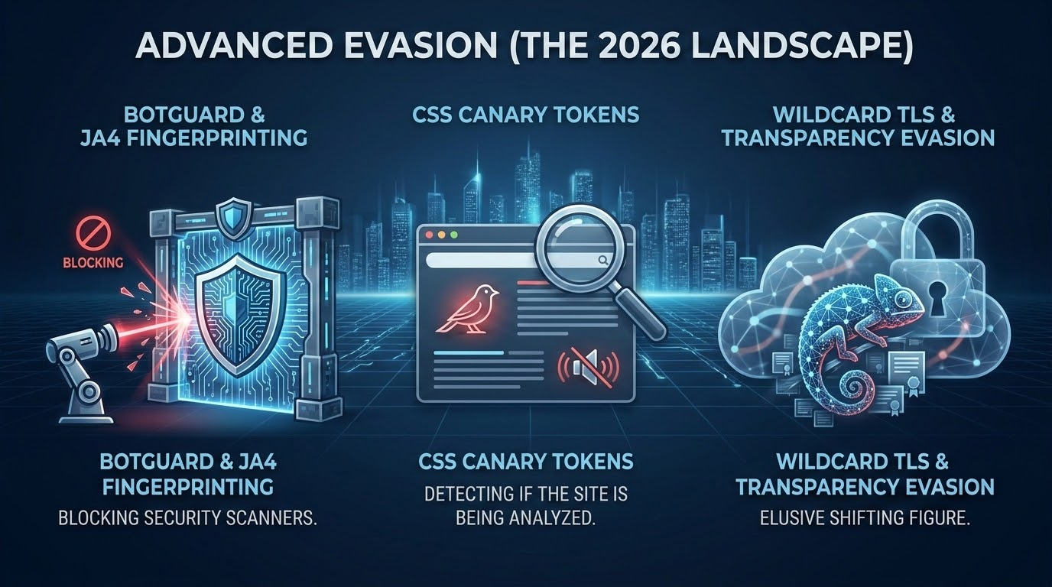
Notes:
The Bouncer: Why don't automated tools kill this? They check IDs.
Digital Accent (JA4): Checking TLS fingerprints. Bots "talk" differently than humans.
The Silent Fail: If it's a security scanner, show a 404. If it's a human in PA, open the door.
Humanity Test: Behavioral gating. Form doesn't appear until mouse moves or window resizes.
Laundering the IP: Residential proxies. It’s coming from a neighbor’s router, not a data center.

Slide 5
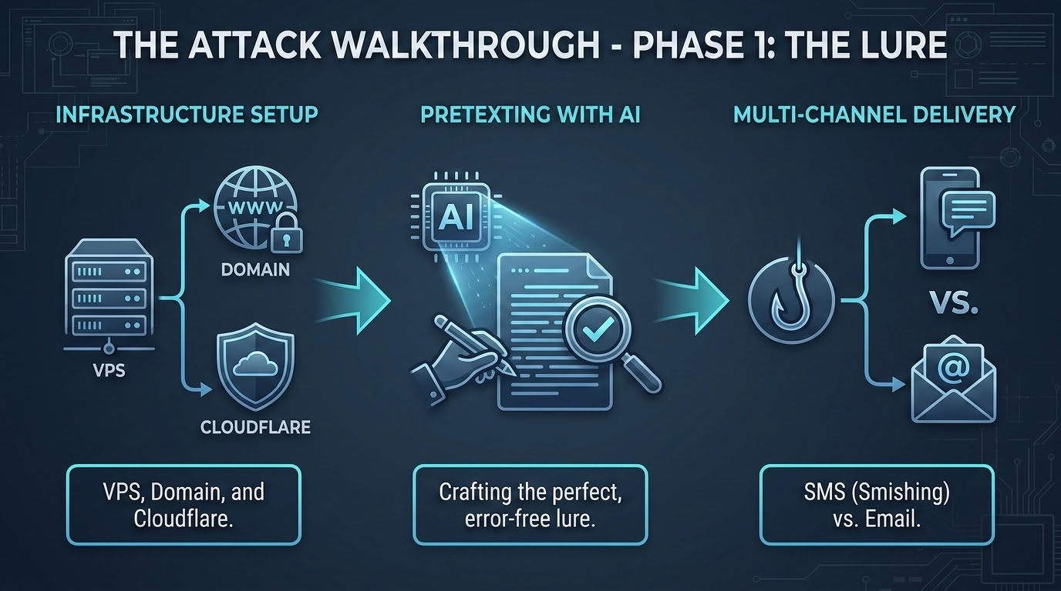
Notes:
The Path of Least Resistance: Moving from the managed laptop to the pocket.
Quishing (QR Phishing): The ultimate "Black Box." Bypasses the entire corporate stack.
Mobile UI: Cramped screens hide malicious URLs. No EDR on a personal iPhone.
Open Redirects: Laundering reputation through google.com or linkedin.com redirects.
High-Fidelity AI: Scraping LinkedIn. "Hey Joel, check the North Lebanon folder." Doubting the boss.
.

Slide 6
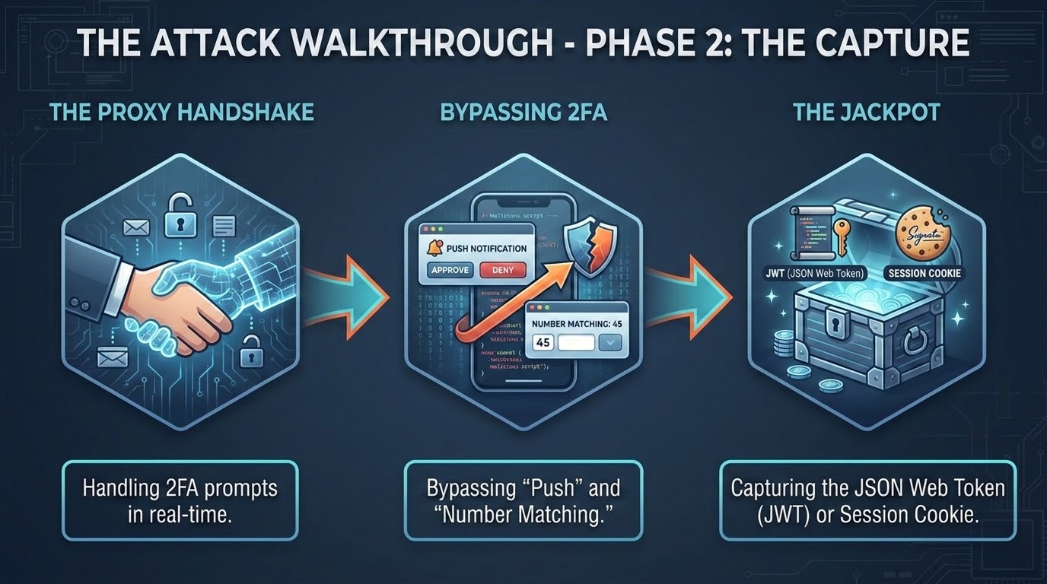
Notes:
The Synchronized Handshake: Mirroring keystrokes to the real Microsoft in real-time.
The Relay: User approves MFA on their phone → Proxy catches the success.
Plucking the Ticket: Capturing ESTSAUTHPERSISTENT. The proof of a completed MFA.
The Clean Hand-off: Redirecting to the real file. No suspicion.
The Win: Attacker doesn't have a password; they have a fully authenticated clone.

Slide 7
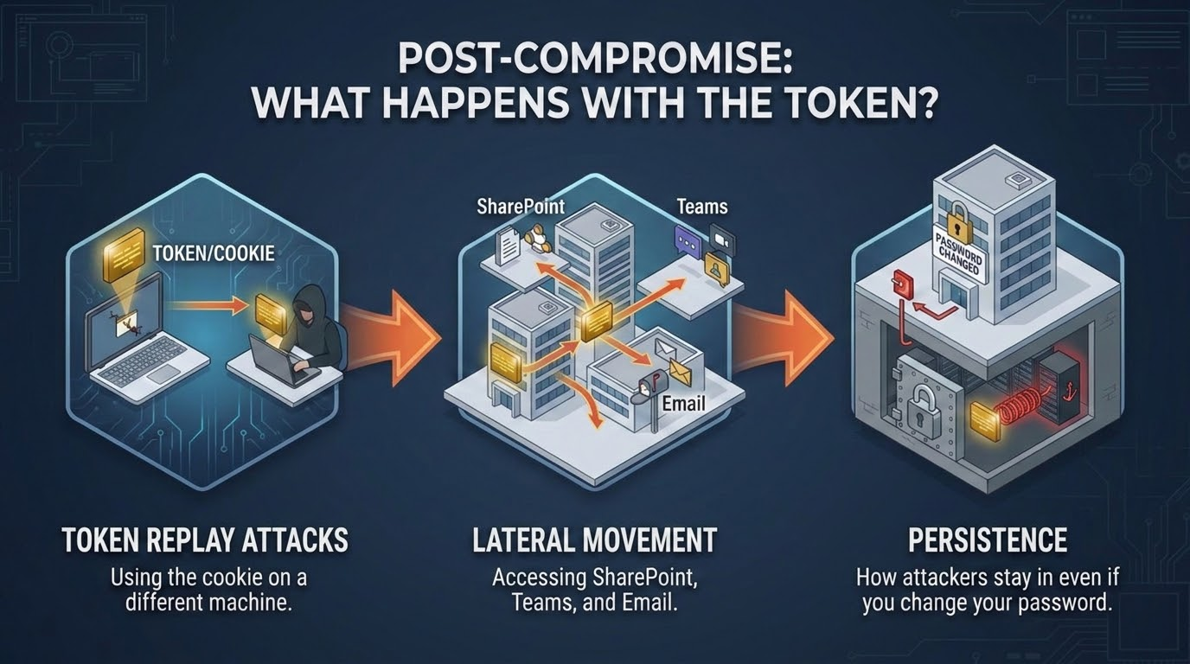
Notes:
The Myth: "Password reset is a Kill Switch." (It's a lie).
Teleportation: Injecting the cookie into a clean browser globally.
Decoupled Identity: Session tokens don't care if the password changed.
The 60-Minute Window: Attacker isn't reading; they're building.
Persistence: Backdoor MFA, malicious OAuth apps, and silent inbox forwarding rules.

Slide 8
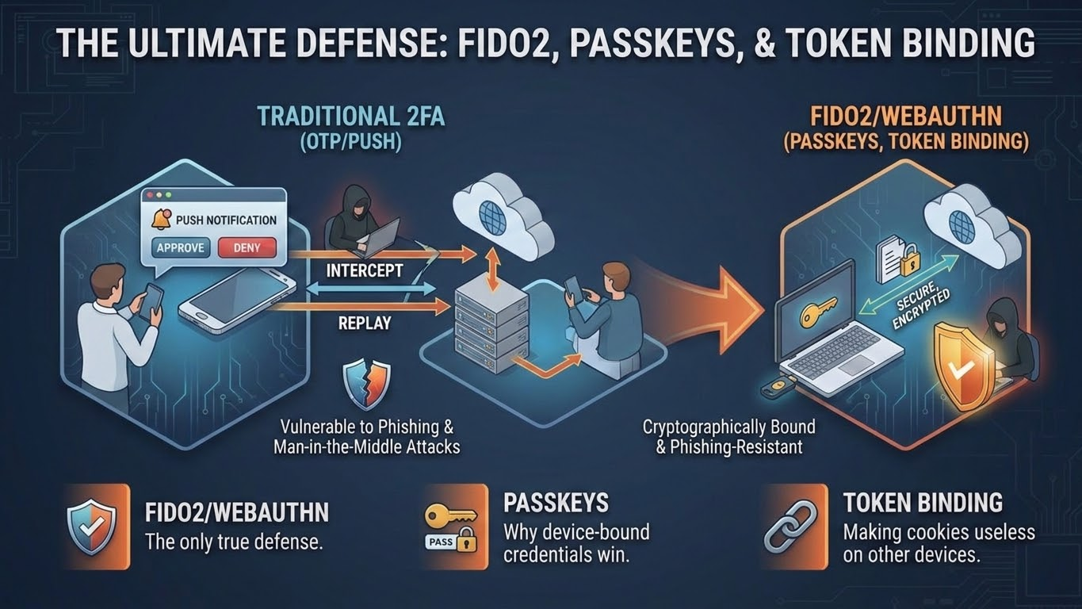
Notes:
The Mirror Shatterer: Changing the physics of the login.
No More Secrets: Asymmetric Cryptography. Private key never leaves the silicon.
Origin Binding: The browser proves the URL to the key.
The Hard Refusal: microsoft-security.com isn't on the list. No signature, no login.
The Burden Shift: Moving defense from the user's eyes to the computer's math.

Slide 9
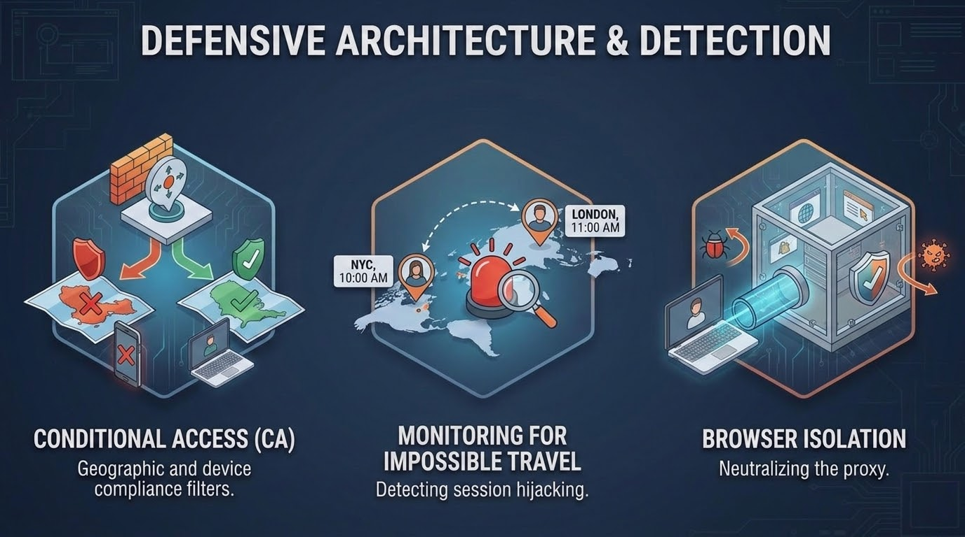
Notes:
Beyond the Login: Locking the active session.
The Digital Brick (DBSC): Binding the cookie to the TPM 2.0 chip on the motherboard.
Hardware Anchor: Token is useless the second it leaves that specific laptop.
The Heartbeat: Continuous Proof-of-Possession. Server asks: "Do you still have the chip?"
CAE: Real-time revocation. Impossible travel = Global kill in under 60 seconds.

Slide 10
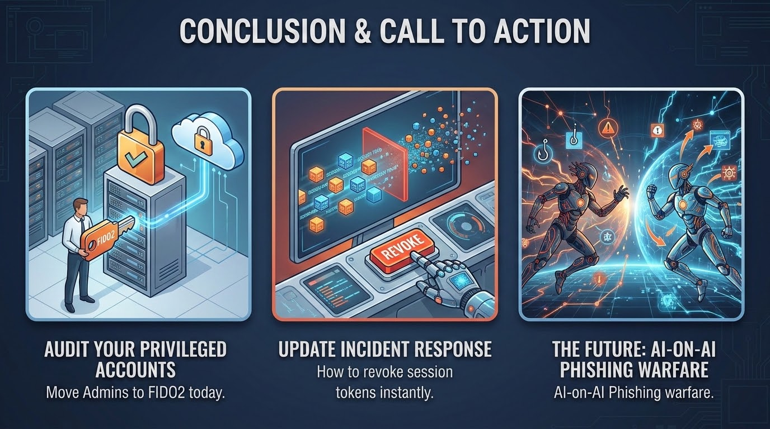
Notes:
Architecture > Awareness: Stop training users to be protocol analysts.
Monday Audit: FIDO2 for all Admins. If they don't have a key, the door is open.
IR Update: Revoke Sessions FIRST, reset password second. Kill the tokens.
The Final Word: Use the hardware you already paid for (TPM/FIDO).
Closing: Blueprints are yours. Drain the watering holes. Thank you, BSides.

Slide 11
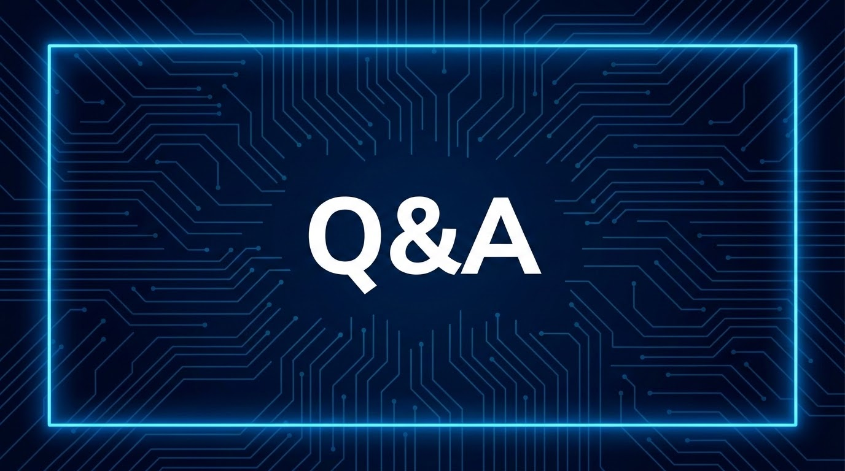
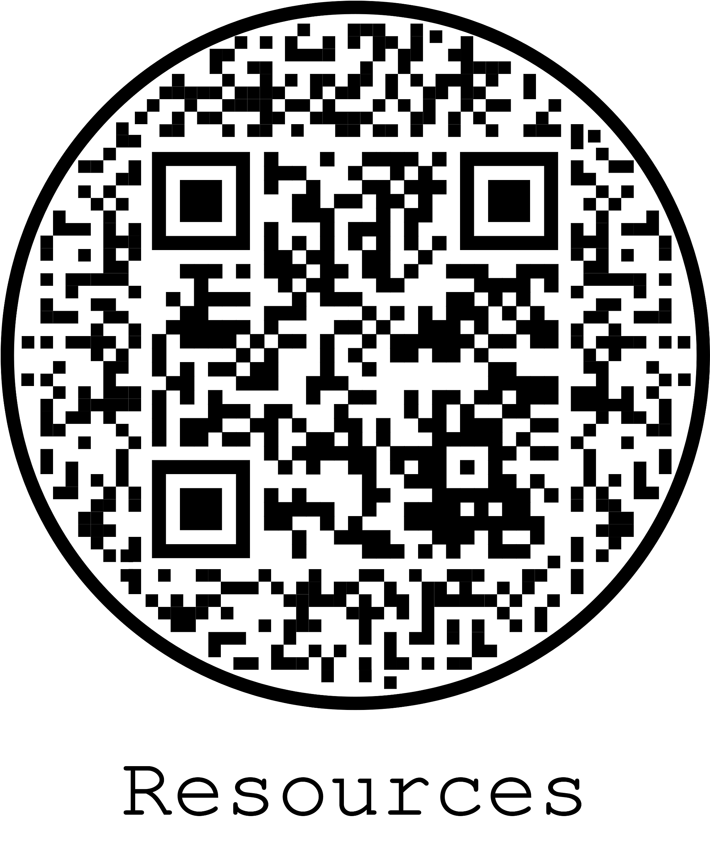
Notes:
Open for questions.
Be ready for: "How much does Evilginx Pro cost?", "Does this work on mobile?", and "How do I revoke tokens in Entra ID?"

